Slide 1

Remote Execution Framework for Hyper-V Ecosystem
Guided by: Mr. Sunil Nair
Sponsored by: Calsoft Inc.

Slide 2
Problem Definition
To create a rich GUI based remote execution Framework for Windows which will offload and execute any executable file onto the specified Virtual Machine on Hyper V Ecosystem.

Slide 3
Motivation:
Microsoft Hyper V server is new and upcoming tool for creating and managing VMs.
Owing to reduced cost and increased flexibility, many companies are switching from VMware to MS Hyper V.
Currently, there are very few frameworks and tools available for manipulating VMs on MS hyper V.
Activities like offloading or installing EXEs require manual assistance.
Manual assistance for such activities is not feasible.

Slide 4
Project Scope
Verification of valid Hyper-V Installation.
Fetching the Inventory from HyperV.
Offloading and executing an EXE.
Creating a rich GUI which will aid in achieving the above tasks.

Slide 5
Requirements
Hardware :
- 1 GB RAM
- 50 GB HDD
Software :
- PowerShell 2.0 onwards
- .NET framework 4.0

Slide 6
Technologies used:
Windows Presentation Foundation - To design the front end of the application.
C#. Net 4.0 - Back end component interaction.
Firebird - To store the previously carried out jobs.
IIS Server 7.0 - To store the executable files
WMI 3.0 - To use Windows Remote Management.
Task Scheduler 2.0 - To schedule jobs.

Slide 7
Technologies:
BITS (Background Intelligent Transfer System):
Background Intelligent Transfer Service (BITS) transfers files (downloads or uploads) between a client and server and provides progress information related to the transfers. You can also download files from a peer , where service always runs in background.

Slide 8
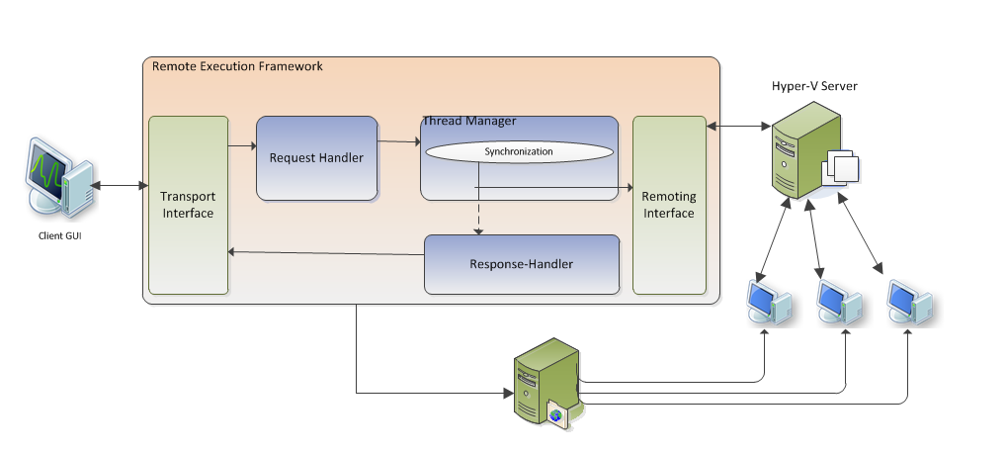
Project Architecture

Slide 9
Our Target: Remote execution in Virtual environment.
Installing any file over a VM based on HyperV server is not an easily achievable task and its alternative is manually attending each VM, which is not feasible. Our target is to automate the process of installing executable files on VM’s from any machine in the network.
Push any file to any virtual machine on hyperV.

Slide 10
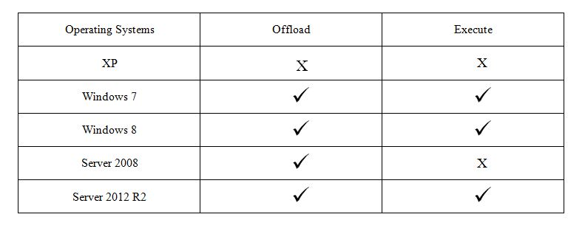
Product Compatibility

Slide 11
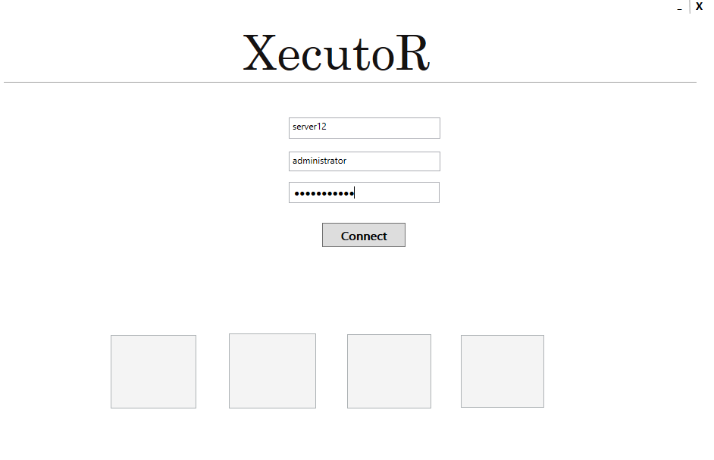
Screenshot: (Authentication Page)
0

Slide 12
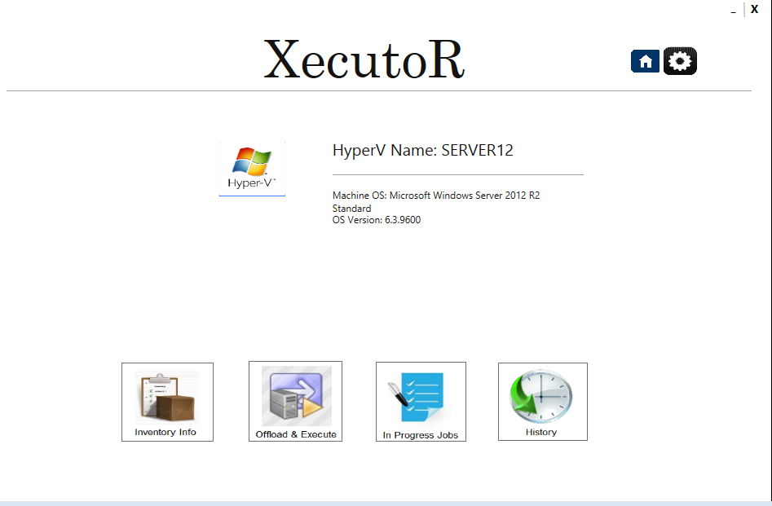
Screenshot: (Landing Page)
0

Slide 13
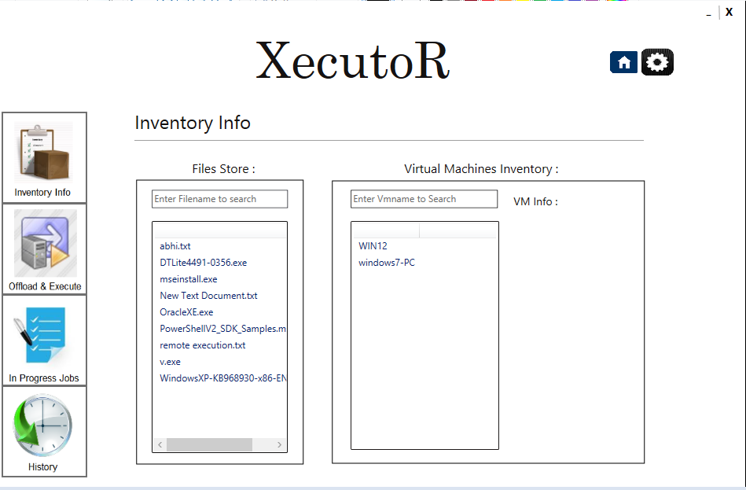
Screenshot: (Inventory Info)
0

Slide 14
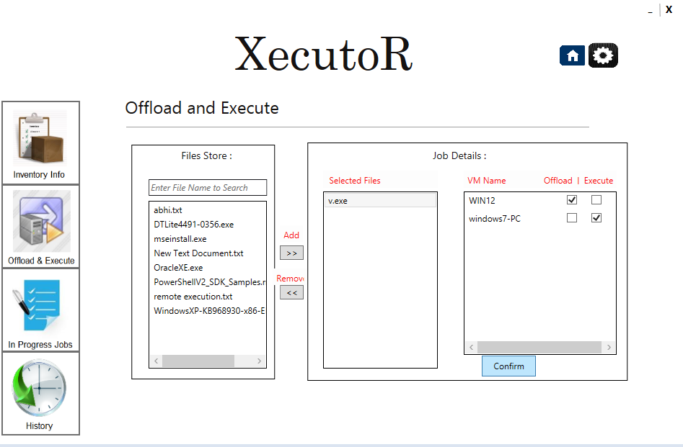
Screenshot: (Offload and Execute)
0

Slide 15
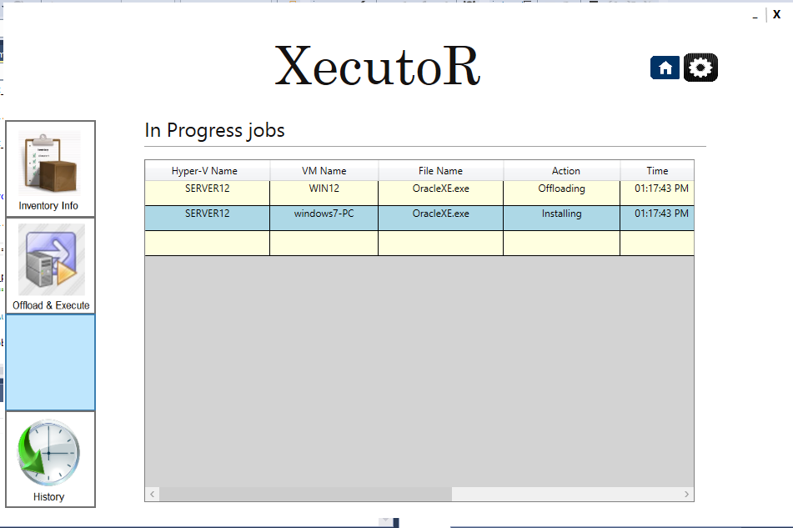
Screenshot: (In Progress )
0

Slide 16
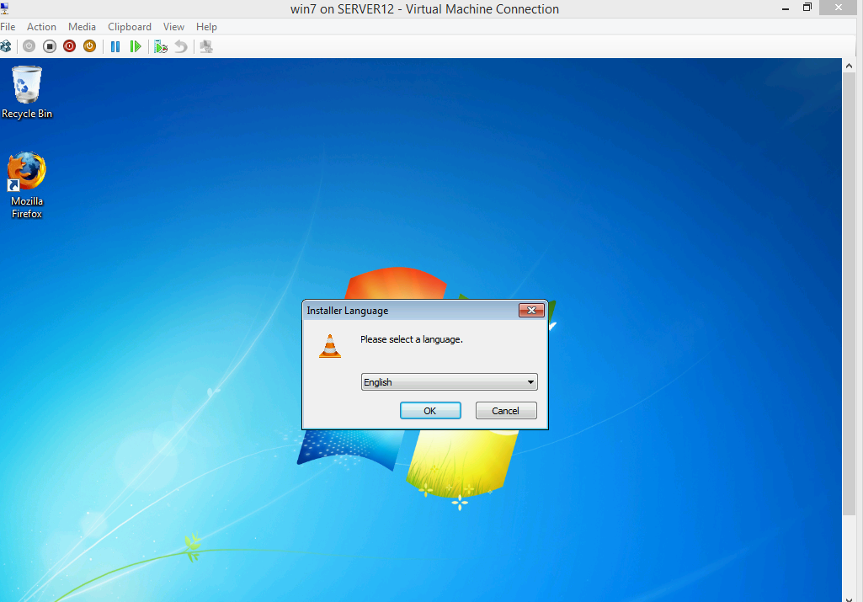
Screenshot: (Output)
0

Slide 17
Conclusion
Essential technologies, languages and concepts required for the project were successfully studied and implemented.
Various aspects of product development like Planning, Coding, Testing and Documentation were successfully learnt and experienced.
The planned product was successfully developed and tested.

Slide 18
Future scope
Extend functionality of remote execution to Linux based machines.
Upgrade tool to include remote monitoring and scaling features.

Slide 19
References
[1] ”Experimental Study of Remote Job Submission and Execution on LRM through
Grid Computing Mechanisms,” Advanced Computing Communication Technologies
(ACCT), 2014 Fourth International Conference on , vol., no., pp.335,341, 8-9
Feb. 2014.
[2] R. L. Henderson, ”Job scheduling under the portable batch system,” in Job
scheduling strategies for parallel processing. Springer, 1995, pp. 279-294.
[3] www.technet.microsoft.com
[4] www.techblogs.com

Slide 20
Thank You.

